Slide 1

Basho Technologies
Riak Enterprise – Multi-datacenter Replication
Notes:
Nodes in a Riak cluster expect low latency connections between each other.
How do I make data available across a WAN?

Slide 2


Slide 3
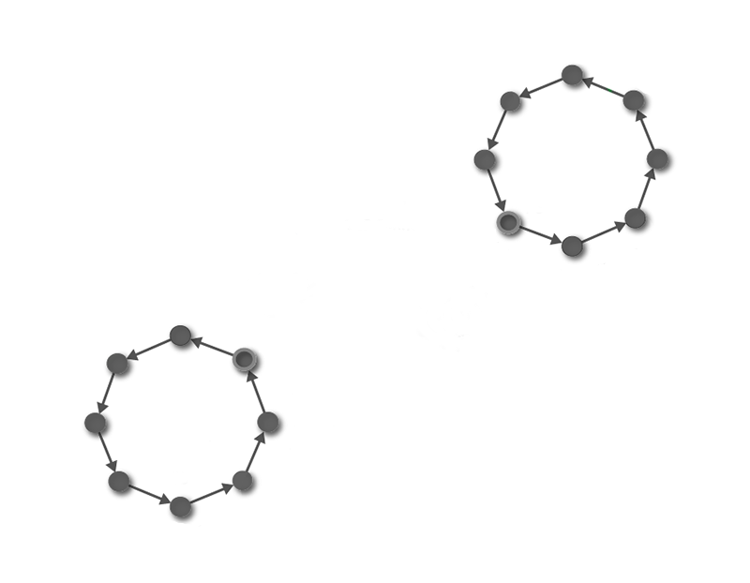
Notes:
Multiple clusters in each datacenter, not one cluster that spans multiple.

Slide 4
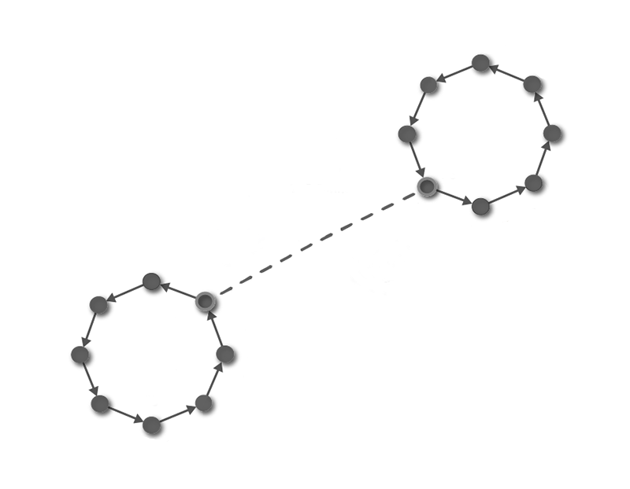
Notes:
-Encrypt connections between datacenters with SSL
-Hook into events in the replication process
-Define replication at the bucket level

Slide 5
Anatomy
Sources
Sinks
Cluster manager

Slide 6
Sources
Notes:
Primary producer of replication data. Pushes data to sink cluster.

Slide 7
Sinks
Notes:
Primary consumer of replication data. Receive data from source cluster.
*Bi-directional*

Slide 8
Cluster Manager
Notes:
The cluster manager is a service that facilitates communication between sink and source clusters.
-Every node runs one Cluster Manager
-Cluster Manager binds to a single port for all communication

Slide 9
Replication Types

Slide 10
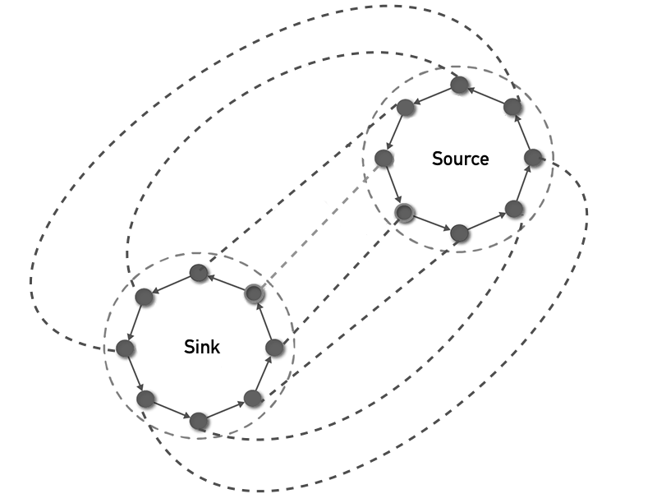

Real-time
Notes:
-Replication from the source doesn’t hit the same vnode in the sink cluster
-Can hit any node similar to running one cluster behind a load balancer

Slide 11
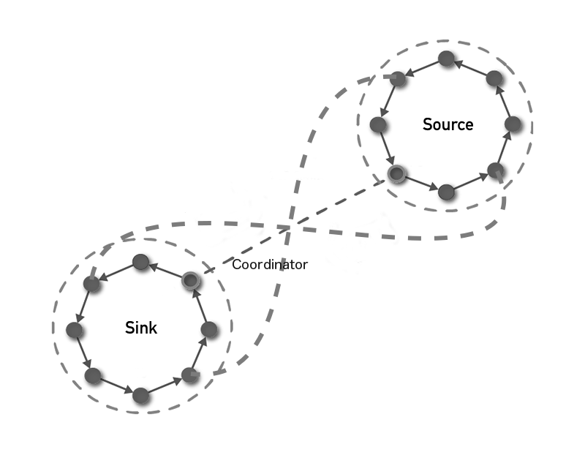
Full Sync
Notes:
-Number of workers per node and per cluster can be bounded
-Full Sync coordinator exchanges metadata to identify objects that are out of sync
-vnodes sync to a corresponding vnode in the other cluster

Slide 12
Riak Enterprise – Multi-datacenter Replication

